Slide 1
CHAPTER 5 Predictive Control with constraints 10 Dual-mode approaches with tracking
Anthony Rossiter

Slide 2
Background
The previous video demonstrated how one could incorporate constraints into an OMPC/SOMPC algorithm.
In simple terms, the easiest method is to form an autonomous model formulation for the predictions and express constraints at each sample using some inequalities.
Finally, use the admissible set algorithm to define the constraints over an infinite prediction horizon in terms of a finite set of inequalities linked to the d.o.f.
The next task is to extend this to tracking scenarios.

Slide 3
Maximal admissible set
Express predictions in the form:
Express constraints at each sample in the form:
The findmas.m code will determine the MAS/MCAS from this data.

Slide 4
Tracking with SOMPC/OMPC
Rewrite the performance index and predicted control trajectory in terms of the deviation variables:
Apart from the simple variable change, this is identical in format to the SOMPC for regulation.

Slide 5
Autonomous model formulation
The autonomous model for prediction is almost identical to the previous video, apart from the use of deviation variables.

Slide 6
Typical constraints
We have to take a little more care with constraints as this are still linked to absolute values.
Limits on an input:
Limits on states:
Input rates are not covered yet.

Slide 7
Combined constraints
Combining the inequalities from the previous pages gives:
Clearly one can add other constraints as required.

Slide 8
Combined constraints
Substituting in for the steady-state:

Slide 9
Summary
We have expressed the state transition and constraints at each sample in the required from and thus can apply the MAS algorithm to these.

Slide 10
Maximal controlled admissible set
The MCAS is given from:
However, this can be expanded to:
Or:
The key change from the previous video is that ‘t’ is different, thus F may also have different rows.

Slide 11
Difficulty
The viewer may have observed that the inequalities depend upon the expected steady-state, and this may change with both the target and disturbance.
This does create a headache for typical MAS algorithms because they assume the inequalities are FIXED and thus the MAS is fixed!
For now we will ignore this subtlety and demonstrate how the MCAS changes for tracking problems.
An alternative is to just define constraints up to a ‘large’ horizon; in practice this could be quite conservative and produce very large numbers of redundant inequalities, but it does mean one has a set of inequalities that work across a range of ‘r, d’.

Slide 12
MATLAB code
Only a few examples are given here as this SOMPC algorithm only words for fixed non-zero targets.
The idea will be simply to demonstrate that the inequalities defining the MCAS can be constructed.
Viewers should note that plotting the regions is none trivial as it requires set projection for which a toolbox such as the MPQP one would be advised.
KEY EXAMPLES ARE IN video5_10_example1.m and video5_10_example2.m
MAIN CODE is chap5_ompc_simulate_constraintsb.m
In OMPC folder.

Slide 13
video5_10_example1.m
Constraints active. QP works well. n_{c}=4
MCAS
MAS
Start point

Slide 14
video5_10_example2.m
Same system but now n_{c}=2.
NOTE MCAS much smaller.

Slide 15
video5_10_example3.m
MIMO example. Again fixed target values.
NOTE: This is SOMPC and not OMPC which is why c_{k} does not go to zero!

Slide 16
WARNING
The MATLAB code provided for determining the MCAS is simple and transparent but by no means efficient.
For slow systems, large numbers of states and so on, viewers are recommended to source more efficient code for handling inequalities.
At the very least one needs an effective mechanism for removing redundant constraints.

Slide 17
Summary
This video has shown how an invariant set or MCAS can be constructed for the OMPC/SOMPC algorithm for a tracking problem.
However, the weakness is that the admissible set algorithm is based on fixed inequalities.
If r or d change, then we need to re-compute our admissible set.
An alternative approach to finding these sets is needed which is more flexible to adaption online.

Slide 18



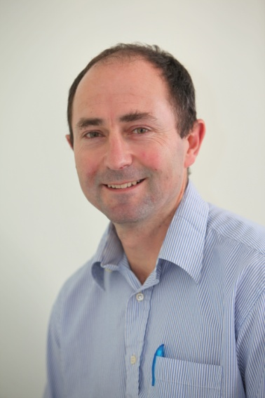
Anthony Rossiter
Department of Automatic Control and Systems Engineering
University of Sheffield
www.shef.ac.uk/acse
© 2014 University of Sheffield
This work is licensed under the Creative Commons Attribution 2.0 UK: England & Wales Licence. To view a copy of this licence, visit http://creativecommons.org/licenses/by/2.0/uk/ or send a letter to: Creative Commons, 171 Second Street, Suite 300, San Francisco, California 94105, USA.
It should be noted that some of the materials contained within this resource are subject to third party rights and any copyright notices must remain with these materials in the event of reuse or repurposing.
If there are third party images within the resource please do not remove or alter any of the copyright notices or website details shown below the image.
(Please list details of the third party rights contained within this work.
If you include your institutions logo on the cover please include reference to the fact that it is a trade mark and all copyright in that image is reserved.)

